Slide 1


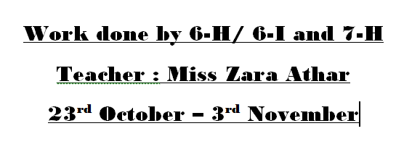



Campaign on Mental Health
By Grade 6- H /6I/ 7-H
Teacher: Miss Zara Athar

Slide 2


Slide 3

What is mental Health?
Mental health includes our emotional, psychological, and social well-being.
It affects how we think, feel, and act. It also helps determine how we handle stress, relate to others, and make choices.
Mental health is important at every stage of life, from childhood and adolescence through adulthood.

Slide 4
Purpose
The purpose of a mental health awareness campaign is to increase the nature, magnitude, and treatment of mental health issues in the population by informing the public about the nature and treatment of mental disorders, which will facilitate early identification and treatment of such problems (WHO, 2004).

Slide 5
Lets look at the students work for this campaign

Slide 6

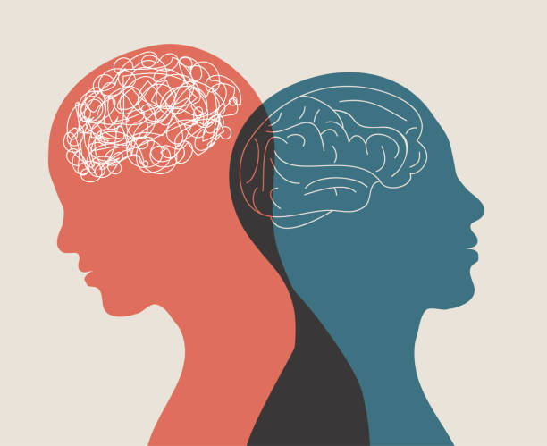
Kenzy Magdy 6-H

Slide 7

Mayisha Khalid 6-h

Slide 8

Marwa Ilyas 6- H

Slide 9
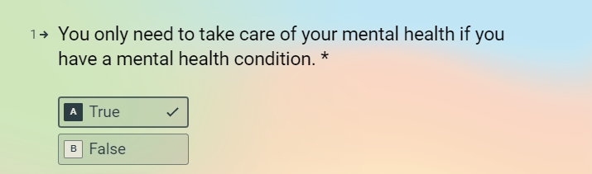
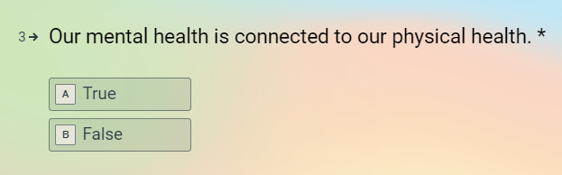
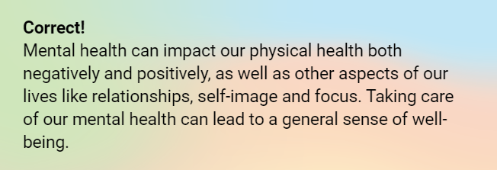
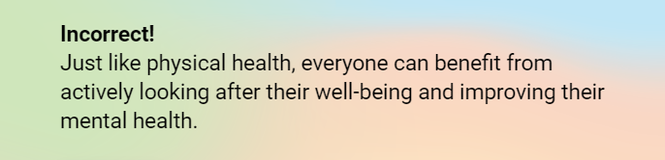
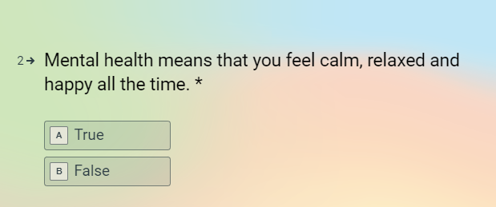
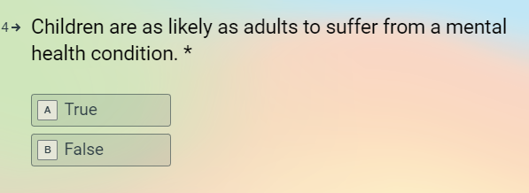
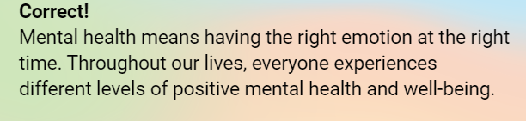
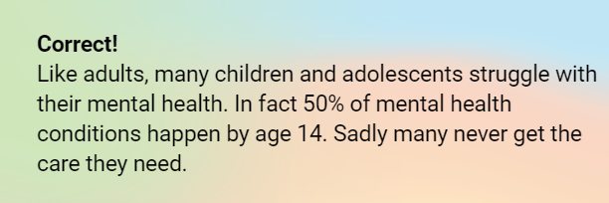
Quiz Activity

Slide 10
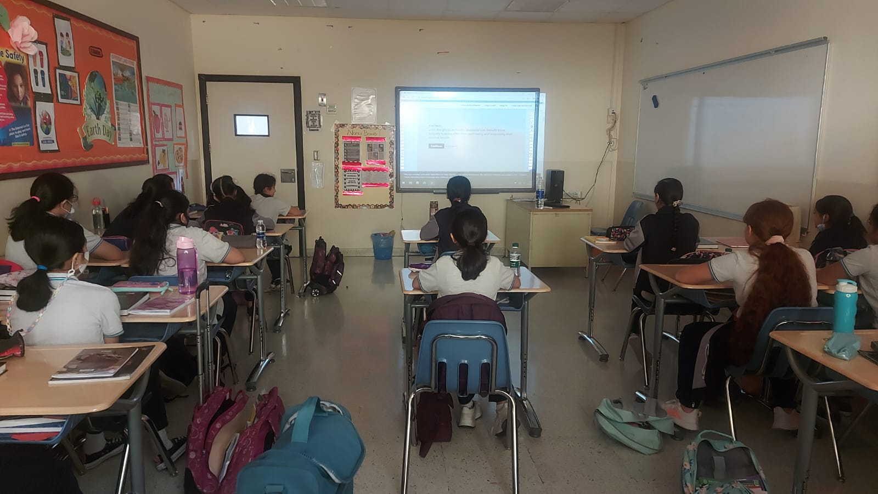
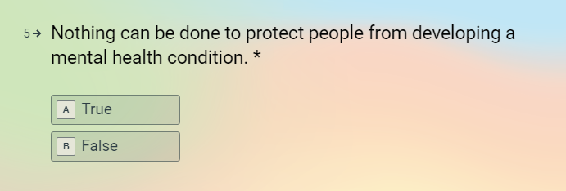
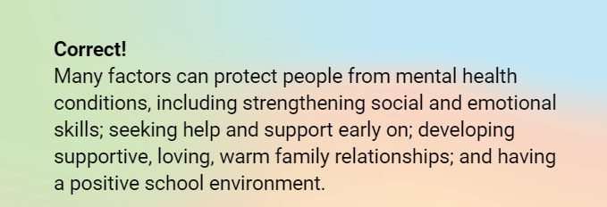

Slide 11
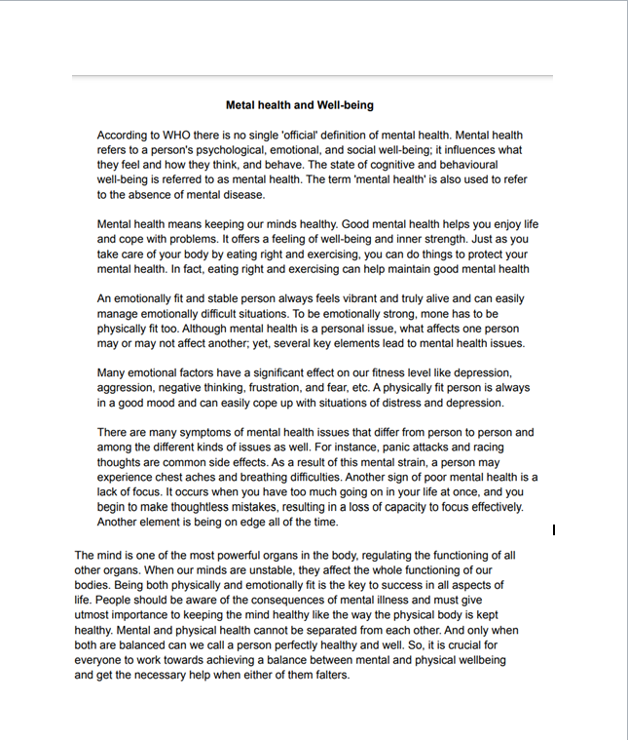
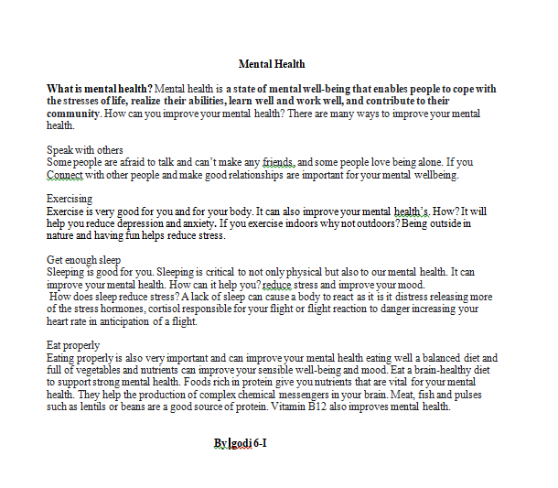
Creative writing by students

Slide 12
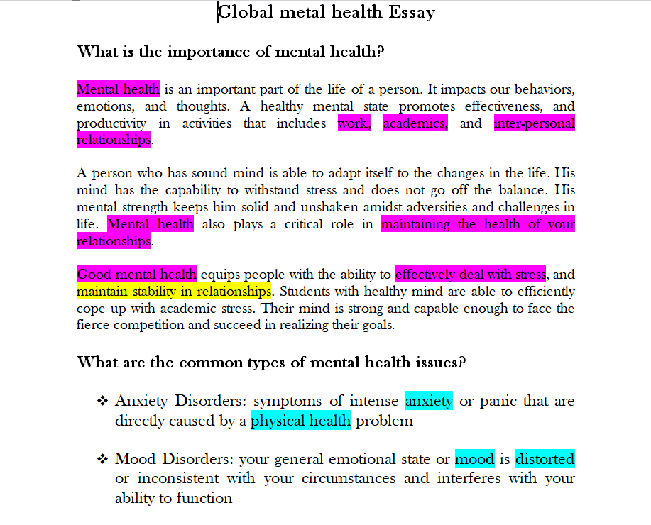
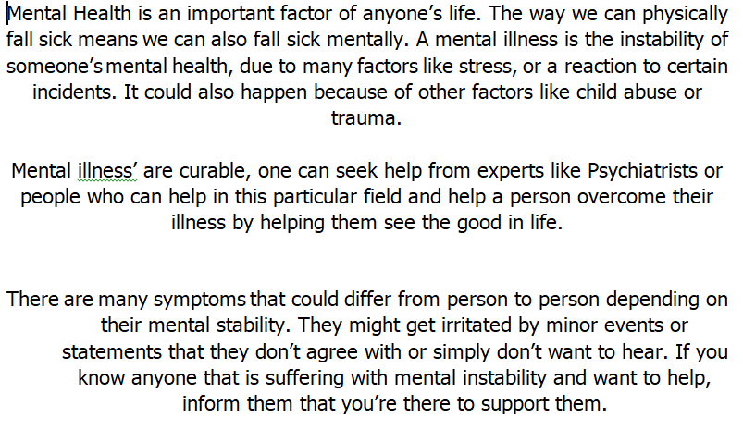
Farah 7- h / Khawlah Hashmi 6-H

Slide 13
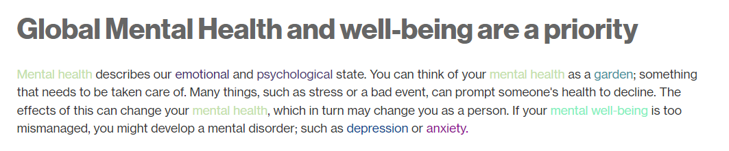


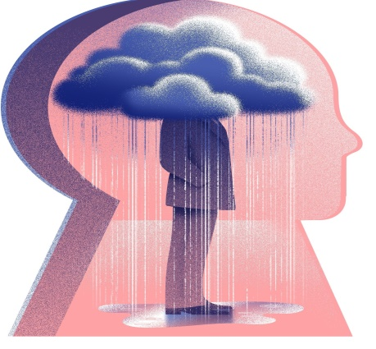
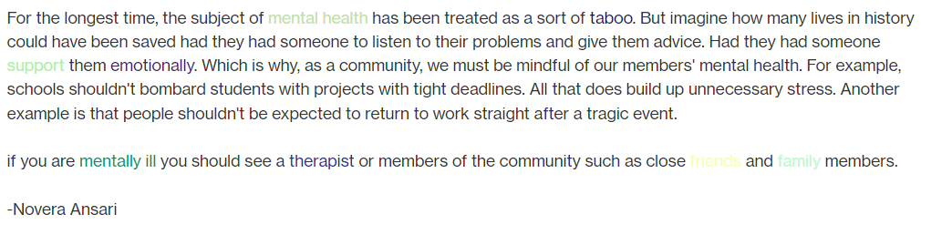
Project By Nowera Ansari 6-H

Slide 14
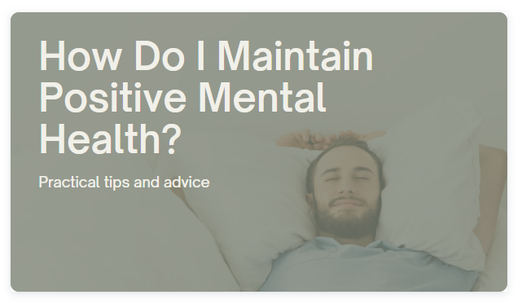
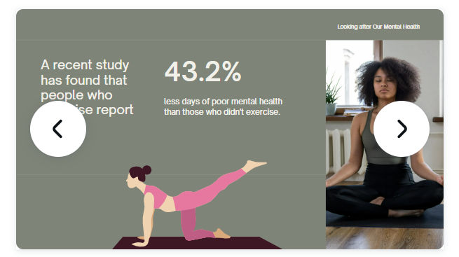
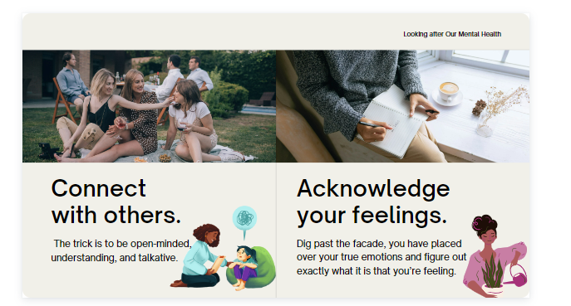
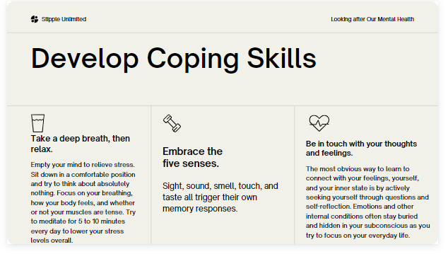
Presentation by Yalini Paratibha 6- I

Slide 15
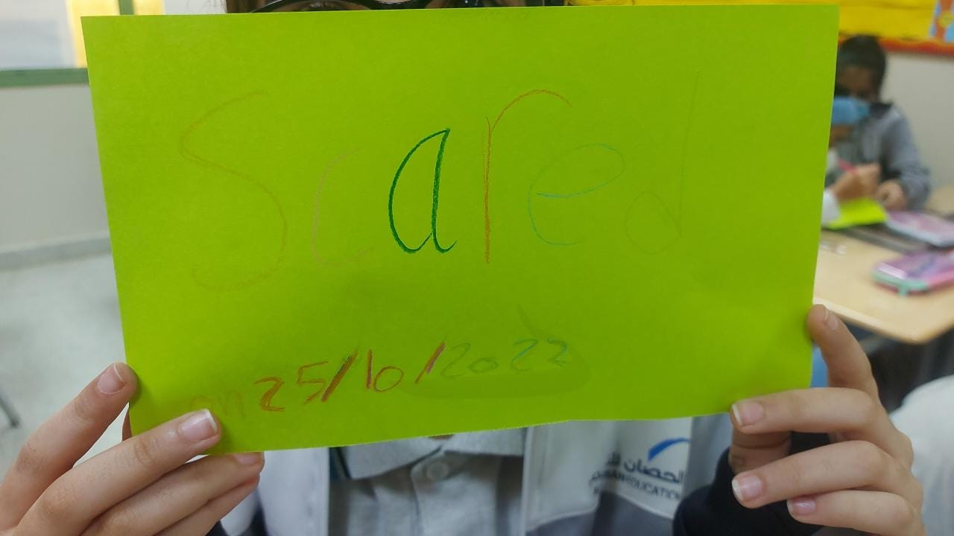
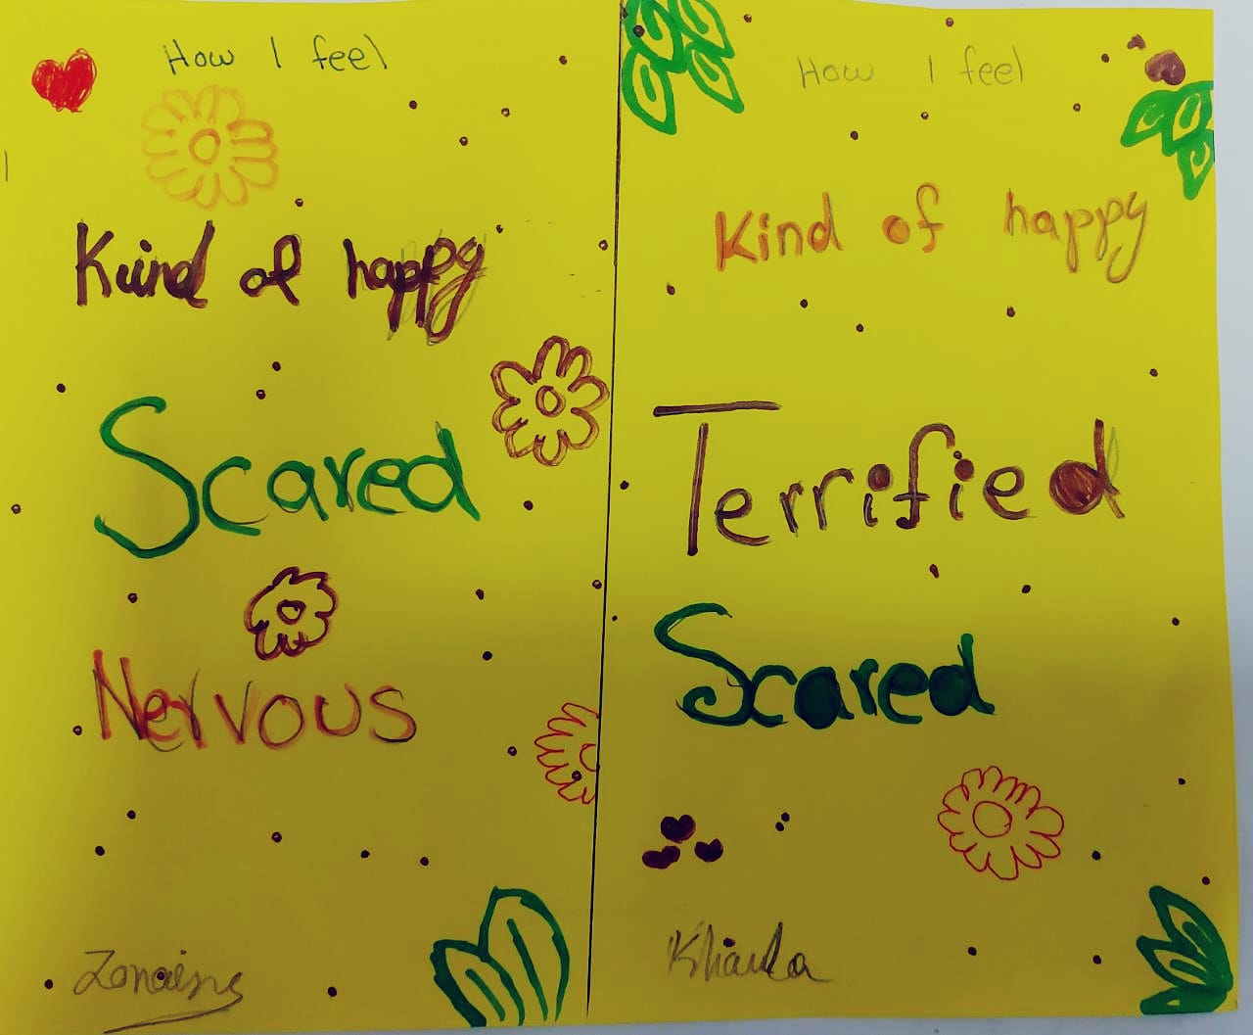
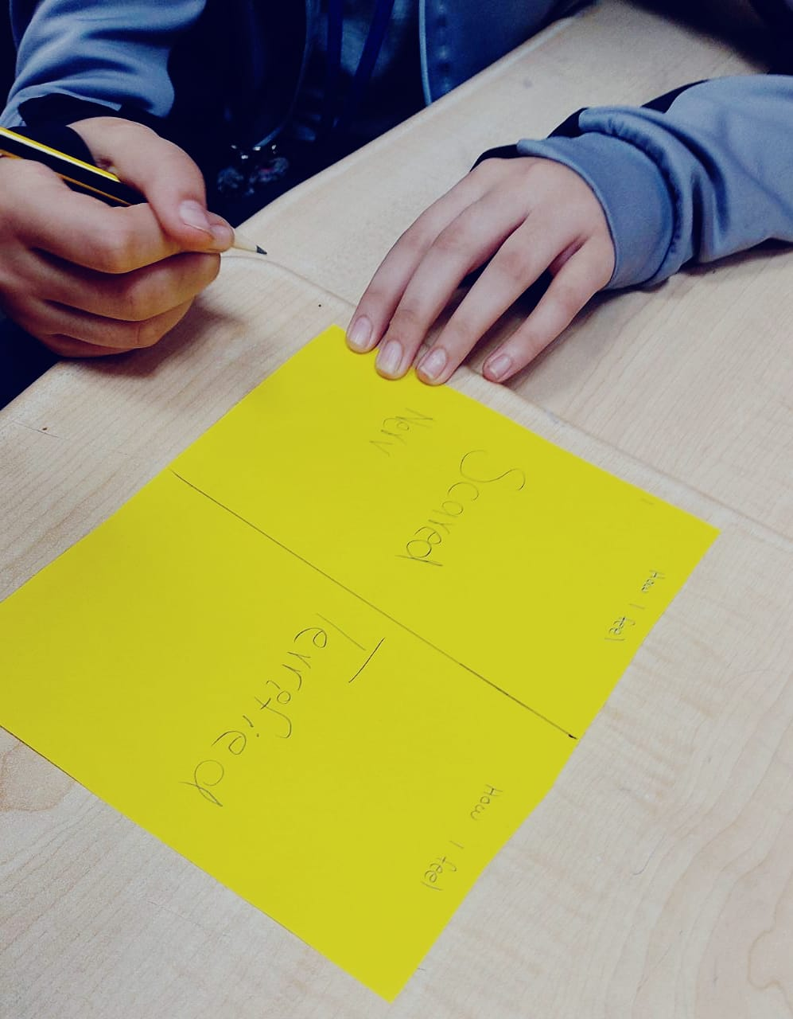
One Word to express Emotions

Slide 16
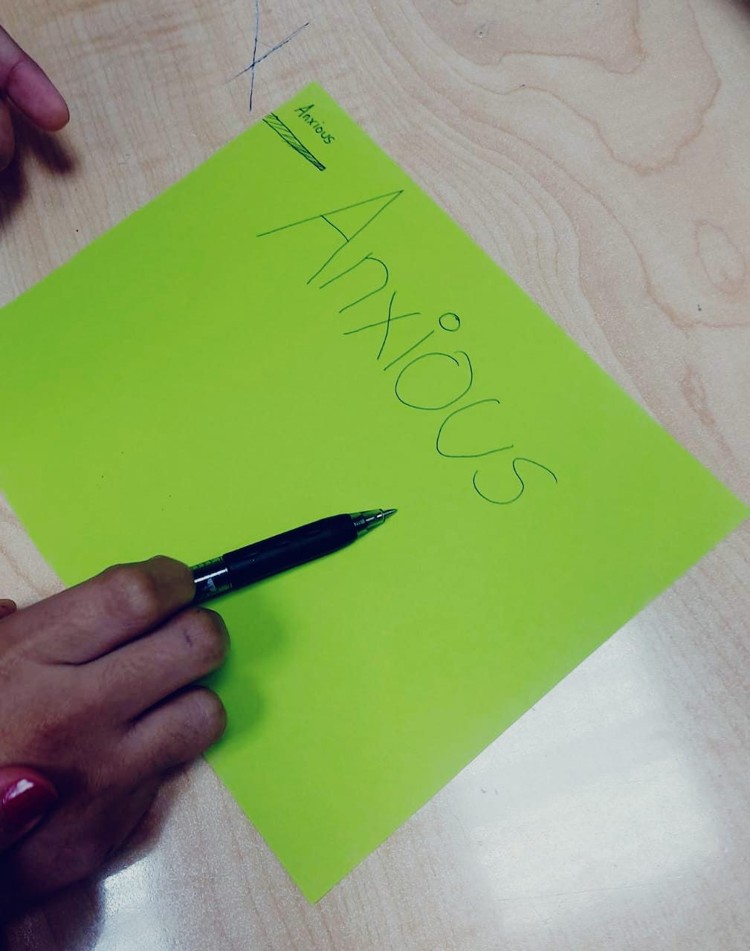



Slide 17


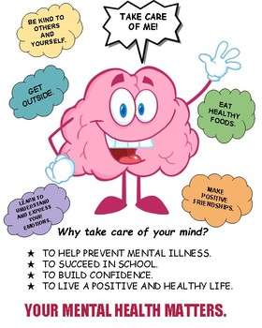
Students Happiness Bringers

Slide 18



